Slide 1
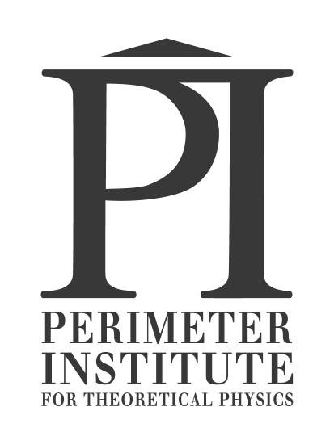
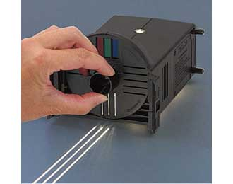
Optics Workshop
Apr. 27, 2012 Session A, 10:45am-noon Time Room
Jason Harlow
University of Toronto, Senior Lecturer in Physics
`
jharlow@physics.utoronto.ca

Slide 2
This Workshop
Every individual should have a stapled hand-out and a foldable voting card
Please form teams of 3 or 4 – you will share a pile of apparatus and work together on the activities (share the mark!)
Introduce yourselves

Slide 3
Quick Survey (showing a blank means “E”)
I am here mostly because I teach:
Grade 10 Science
Grade 11 Physics
Grade 12 Physics
Other
University courses

Slide 4
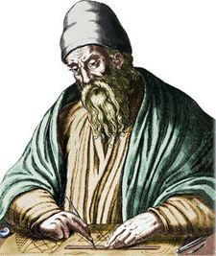
Some historical tidbits…
300 B.C. – Euclid of Alexandria noted that light travels in straight lines, and wrote down the Law of Reflection for plane mirrors:
The angle of incidence = The angle of reflection
Unfortunately, Euclid believed that vision was due to our eyes emitting rays of light.

Slide 5
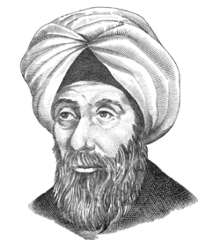
History of Light
1000 A.D. – Alhazen of Basra considered the law of reflection in 3-D, noting that the angles of incidence and reflection are in the same plane normal to the interface.
Alhazen proved experimentally that vision is due to light proceeding to our eyes, from each point on an object. He also investigated refraction, pinhole cameras, and lenses.

Slide 6
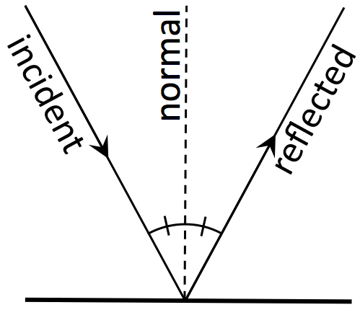
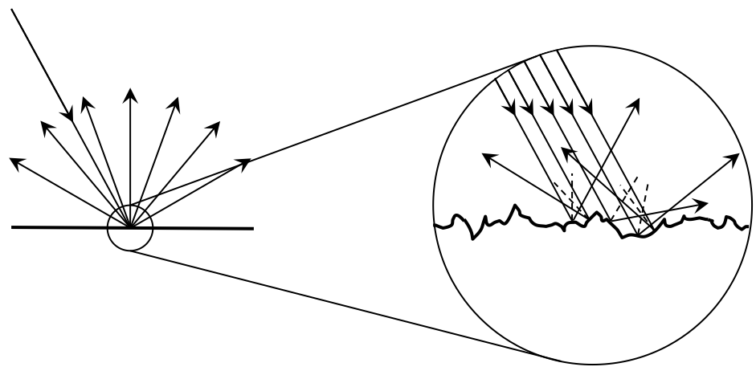
Activity 1: How do we see? Background
Specular Reflection
Mirrors, shiny objects
“The Law of Reflection”
Diffuse Reflection
When the surface is bumpy on the microscopic level
Everything else!
Macroscopically, the law of reflection is not obeyed!

Slide 7
Activity 1: Pre-activity Quick-Check
When considering a single mathematical ray of light (single photon), to what does the law of reflection apply?
Specular reflection
Diffuse reflection
Both
Neither

Slide 8
Activity 1: Pre-activity Quick-Check
When considering a single mathematical ray of light (single photon), to what does the law of reflection apply?
Specular reflection
Diffuse reflection
Both
Neither

Slide 9
Activity 1: Pre-activity Quick-Check
When considering an actual beam of light, such as the beam from a laser pointer, to what does the law of reflection apply?
Specular reflection
Diffuse reflection
Both
Neither

Slide 10
Activity 1: Pre-activity Quick-Check
When considering an actual beam of light, such as the beam from a laser pointer, to what does the law of reflection apply?
Specular reflection
Diffuse reflection
Both
Neither
Diffuse reflection of a beam

Slide 11
Activity 1: How do we see? Activity
~ 10 Minutes
Work together! Include all team members
You will “turn in” only one hand-out for your team, so after discussion and practice make one your “good copy”

Slide 12
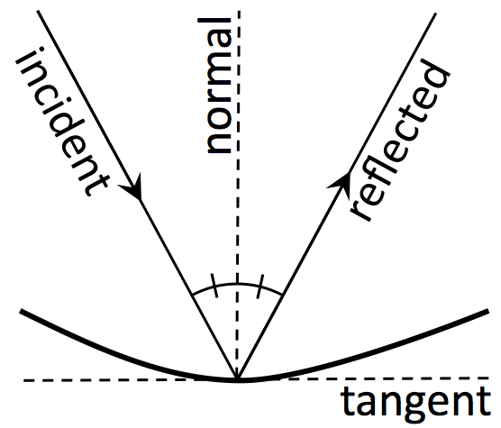
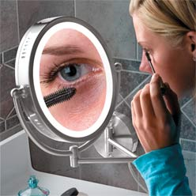
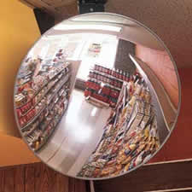
Activity 2: Where is the Focal Point of a Concave Spherical Mirror? Background
The law of reflection also applies to curved surfaces
The normal is the line which is perpendicular to the tangent plane at the point where the incident ray hits the surface
Concave
Convex

Slide 13
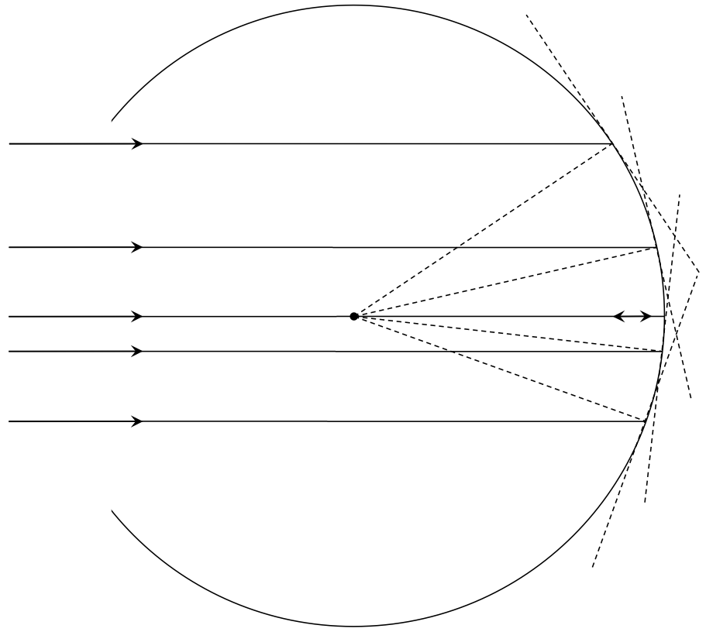
Activity 2: Where is the Focal Point of a Concave Spherical Mirror? Activity
~ 15 Minutes – Label C and F
Work together! Include all team members
You will “turn in” only one hand-out for your team, so after discussion and practice make one your “good copy”

Slide 14
Activity 2: Post-activity Understanding Question
When a beam of light, composed of many parallel rays, reflects from a concave mirror
The reflected rays spread out
The reflected rays are parallel to each other
The reflected rays converge towards a focus point
The reflected rays rays converge, but don’t necessarily pass through a focus point

Slide 15
Activity 2: Post-activity Understanding Question
When a beam of light, composed of many parallel rays, reflects from a concave mirror
The reflected rays spread out
The reflected rays are parallel to each other
The reflected rays converge towards a focus point
The reflected rays rays converge, but don’t necessarily pass through a focus point

Slide 16
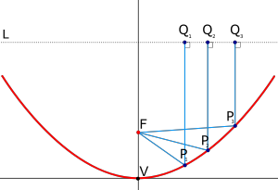
Activity 2: Post-activity Note
There is one particular type of concave surface that does reflect parallel rays to a single focus: a parabola
A circle is similar to a parabola if you only use a small portion of it

Slide 17
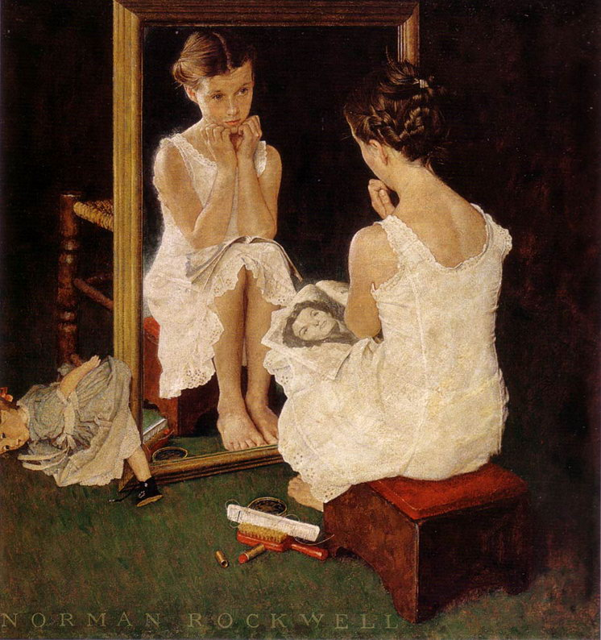
Activity 3
“Why do mirrors reverse left-to-right and not up-to-down?”
~ 10 minutes

Slide 18
Activity 3: Post-activity Understanding Question
Which way does a mirror reverse the image?
Left-to-right
Up-to-down
Front-to-back

Slide 19
Activity 3: Post-activity Understanding Question
Which way does a mirror reverse the image?
Left-to-right
Up-to-down
Front-to-back

Slide 20
Activity 3: Post-activity Note
Mirrors reverse the image front-to-back relative to the original object
Bob needs to turn in order to face Alice, and he actually has two choices of how to do this: he can stand on his head or he can turn left or right 180 degrees
Since it’s easier to turn than stand on your head, we do it every time
That’s why we think mirror reverse left and right
It is Bob that reverses that way, not the mirror.

Slide 21
Activities 4 and 5 Lab Exercises
~ 15 Minutes each
We may need to dim the lights a bit
These ray boxes can shine a single ray (Activity 4) or a set of 5 parallel rays (Activity 5) on the table surface or a piece of paper
jharlow@physics.utoronto.ca

